Slide 1
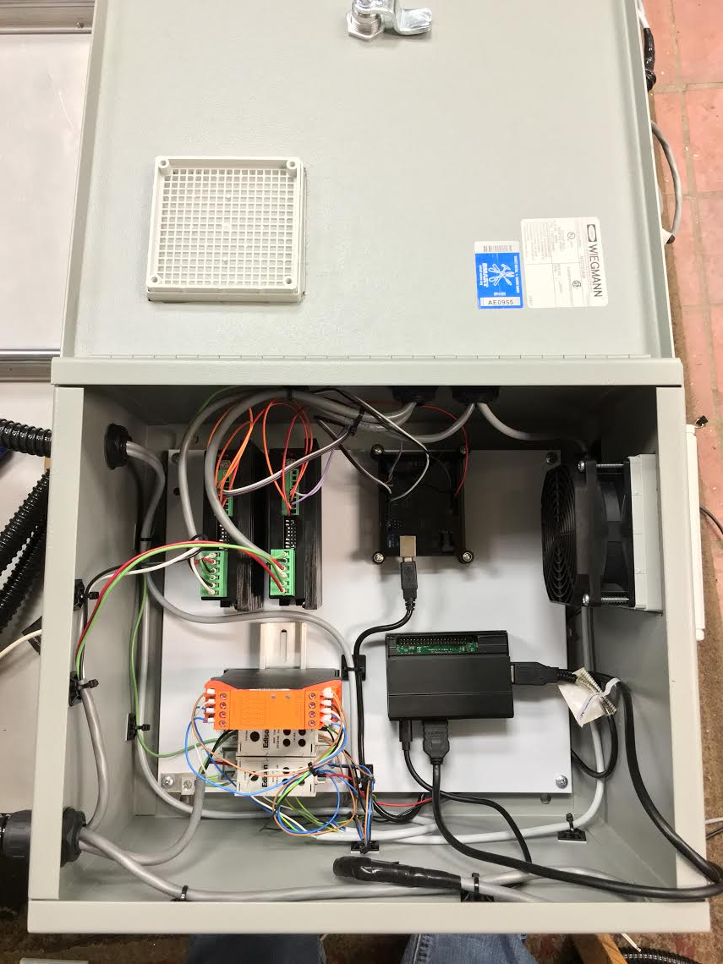
Systems - Logic Control Module
Computer runs GUI
Arduino controls stepper drivers
Stepper drivers send signal to the motors
Safety Relay controls light bar, stack lights, and raspberry pi

